Slide 1

Houston, TX
2019
#XamDevSummit

Slide 2


The Escape Room
Allan Ritchie
@allanritchie911

Slide 3

The Objective
The goal of this workshop is to have everyone find the bomb and enter the disarm code
Build an app that uses BluetoothLE to talk find the bomb
Use the app to read/write/get notifications to figure out the disarm code
The disarm code does change from each attempt – make sure you disconnect once you’re done
You can work together as any size team(s) you would like or even go solo
Once you enter the correct code, you can still talk to others, but you cannot help them code/type anything

Slide 4
Suggestions
There will be periodic hints given, so make sure you are always paying attention to what’s going on around you.
The next screen contains clues how how to get the disarm code
Don’t be discouraged, I’ll be coming around and giving hints
You will have an easier time doing this on iOS
WARNING – if you send back the wrong secret, you won’t be told if you’re right or wrong – this is to stop you from spamming – you have to use the PIN pad ☺
There is a project at https://github.com/aritchie/xdsworkshop - feel free to use it or go your own way

Slide 5

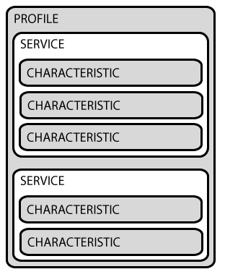
What is Bluetooth(LE)
Advertising - it let’s you know of its existence
Traditional/Classic Bluetooth is a just a read & write stream
LE adds Generic Attribute Profile (GATT) – this is a series of services and CHARACTERISTICS
GATT is made up of services & characteristics (descriptors as well, but not needed for the most part)
WebAPI equivalents - Controllers = Service | Characteristics are the endpoints
Characteristics can read, write, or notify (SignalR)

Slide 6

CLUES
First you have to find the bomb – It is pretty obvious if you “scan” properly - “Nexus 6P”
Now that you’ve found it – you have to first ”get” a secret from “A495FF21…”
Now whisper that secret back to C2 to make sure I know who you are
Lastly, read one more time from
Now ”whisper” the secret back to C2 and C3 will give you what you need
The disarm code can be translated to your readable code using BitConverter.ToInt32
TAKE A PHOTO – this won’t be up all the time

Slide 7
Resources
https://github.com/aritchie/bluetoothle
https://github.com/shinyorg/shiny
https://github.com/shinyorg/shinysamples
https://github.com/xabre/xamarin-bluetooth-le

Slide 8
Thank You!

